Slide 1
Lecture 2
Lexical Analysis

Slide 2
Regular Expressions
Regular expressions are a family of descriptions that can be used to capture certain languages (the regular languages).
Often provide a compact and human-readable description of the language.

Slide 3
Atomic Regular Expressions
The regular expressions we will use in this course begin with two simple building blocks.
The symbol ε is a regular expression matches the empty string.
For any symbol a, the symbol a is a regular expression that just matches a.

Slide 4
Compound Regular Expressions
If R1 and R2 are regular expressions, R1R2 is a regular
expression represents the concatenation of the
languages of R1 and R2.
If R1 and R2 are regular expressions, R1 | R2 is a regular expression representing the union of R1 and R2.
If R is a regular expression, R* is a regular expression for the Kleene closure of R.
If R is a regular expression, (R) is a regular expression with the same meaning as R.

Slide 5
Operator Precedence
Regular expression operator precedence is
(R)
R*
R1R2
R1 | R2
So ab*c|d is parsed as ((a(b*))c)|d

Slide 6
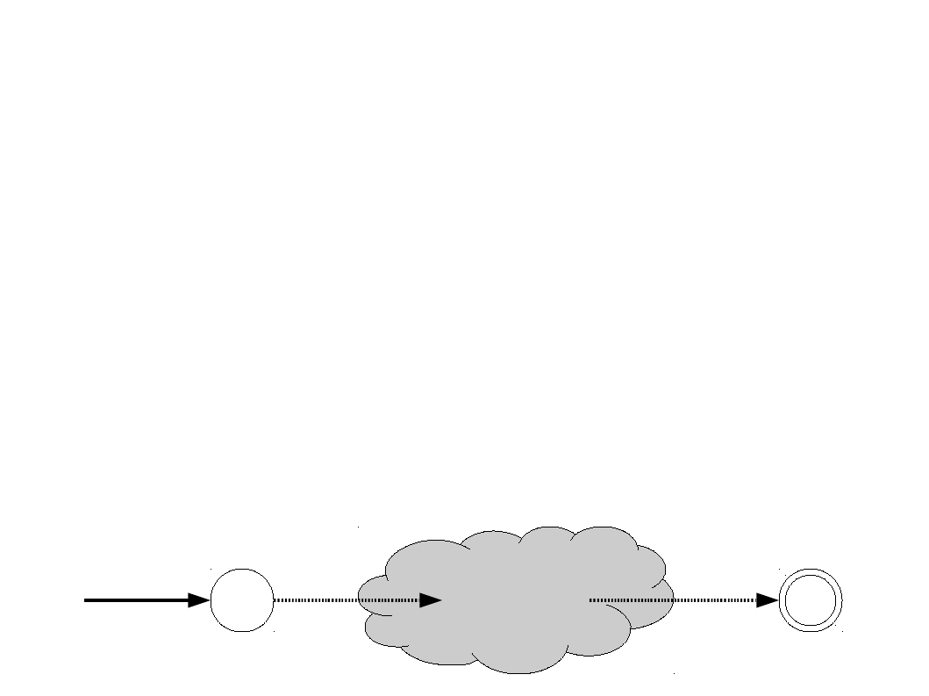
From Regular Expressions to NFAs
There is a (beautiful!) procedure from converting a regular expression to an NFA.
Associate each regular expression with an NFA with the following properties:
There is exactly one accepting state.
There are no transitions out of the accepting state.
There are no transitions into the starting state.
These restrictions are stronger than necessary, but make the construction easier.
start

Slide 7
两种转换方法对比
Inductive Method (逐步分解)
优点：生成的NFA中ε边的数量通常明显比Thompson Construction Method 少，需要更少的存储空间以及后续生成DFA的计算量
不足：中间产生的NFA并不是严格意义上的NFA，因为一条边上要标记的很可能是一个复合正则表达式，而不是单个符号或ε，需要维护更复杂的数据结构
Thompson Construction Method (递归构造)
优点：中间产生的NFA都是严格意义上的NFA，可保证每条边上标记的都是单个符号或ε，只需要维护简单的数据结构
不足：生成的NFA中ε边的数量通常明显比Inductive Method多，需要更多的存储空间以及后续生成DFA的计算量
都能得到等价的NFA，最后得到的最小DFA完全相同.

Slide 8
两种方法对比
Inductive Method (逐步分解)
优点：生成的NFA中ε边的数量通常明显比Thompson Construction Method 少，需要更少的存储空间以及后续生成DFA的计算量
不足：中间产生的NFA并不是严格意义上的NFA，因为一条边上要标记很可能是一个复合正则表达式，而不是单个符号或ε，需要维护更复杂的数据结构
Thompson Construction Method (递归构造)
优点：中间产生的NFA都是严格意义上的NFA，每条边上要标记都是单个符号或ε，只需要维护简单的数据结构
不足：生成的NFA中ε边的数量通常明显比Inductive Method多，需要更多的存储空间以及后续生成DFA的计算量
都能得到等价的NFA，最后得到的最小DFA完全相同.

Slide 9
Construct NFA for each basic regular expression
1. NFA for ε
ε
start
x
y
2. NFA for single character a
a
start
x
y

Slide 10
Construct NFA for complex regular expressions
(1) The NFA for regular expression “e” is
e
start
x
y
(2) Break up the NFA basing on the following three operations until the arrowed line is labeled by only characters
e₁
e₁
e₁
e₂
ε
ε
start
X
y
start
X
1
y
start
X
1
y
e₂
e=e₁|e₂
e=e₁e₂
e=e₁*

Slide 11
两种方法对比
Inductive Method (逐步分解)
优点：生成的NFA中ε边的数量通常明显比Thompson Construction Method 少，需要更少的存储空间以及后续生成DFA的计算量
不足：中间产生的NFA并不是严格意义上的NFA，因为一条边上要标记很可能是一个复合正则表达式，而不是单个符号或ε，需要维护更复杂的数据结构
Thompson Construction Method (递归构造)
优点：中间产生的NFA都是严格意义上的NFA，每条边上要标记都是单个符号或ε，只需要维护简单的数据结构
不足：生成的NFA中ε边的数量通常明显比Inductive Method多，需要更多的存储空间以及后续生成DFA的计算量
都能得到等价的NFA，最后得到的最小DFA完全相同.

Slide 12
Base Cases
start
ε
Automaton for ε
start
a
Automaton for single character a

Slide 13
Construction for R1R2

Slide 14
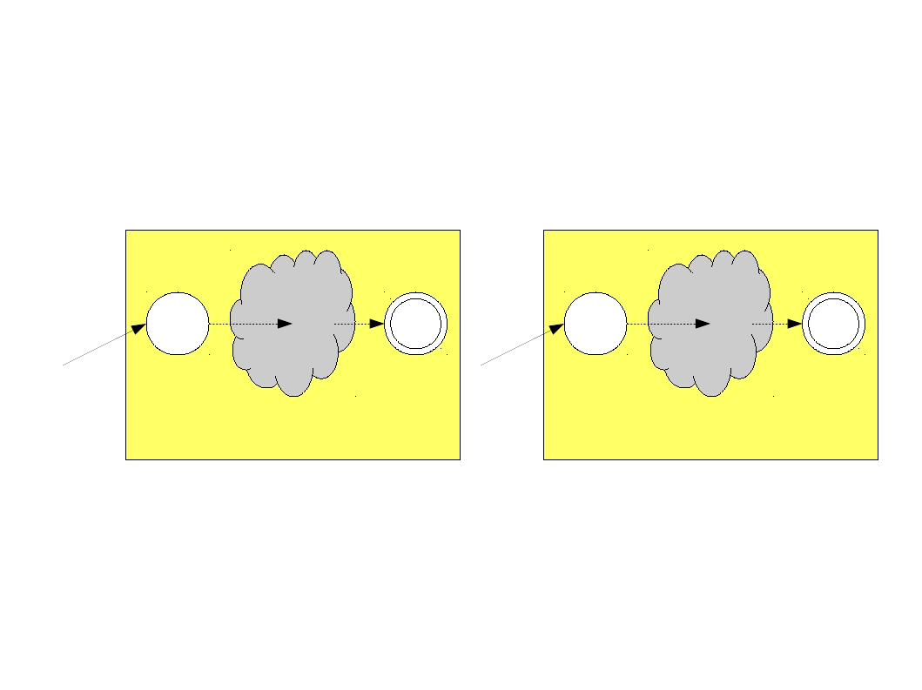
Construction for R1R2
start
start
R1
R2

Slide 15

Construction for R1R2
start
R1
R2

Slide 16

Construction for R1R2
ε
start
R1
R2

Slide 17

Construction for R1R2
ε
start
R1
R2

Slide 18
Construction for R1 | R2

Slide 19
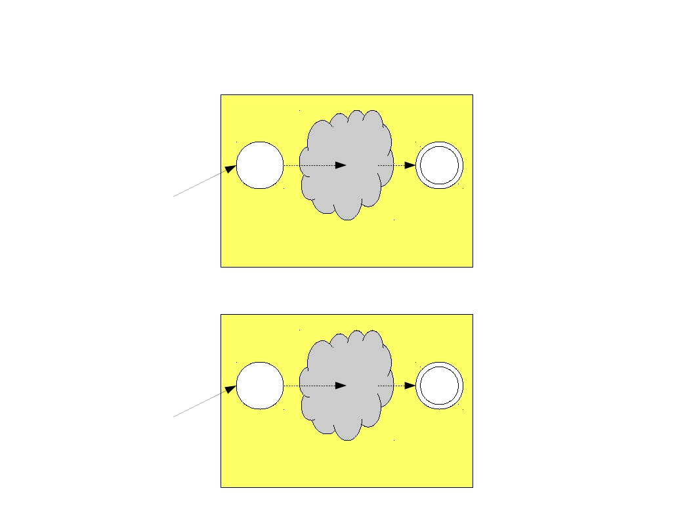
Construction for R1 | R2
start
R1
start
R2

Slide 20
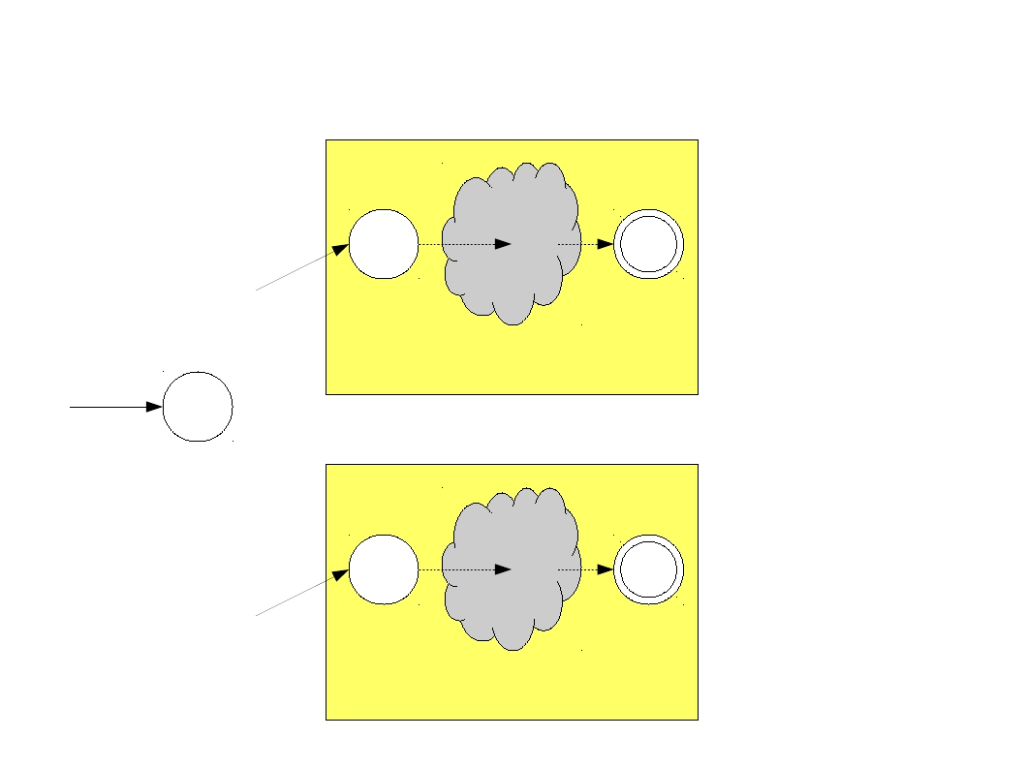
Construction for R1 | R2
start
start
R1
R2
start

Slide 21
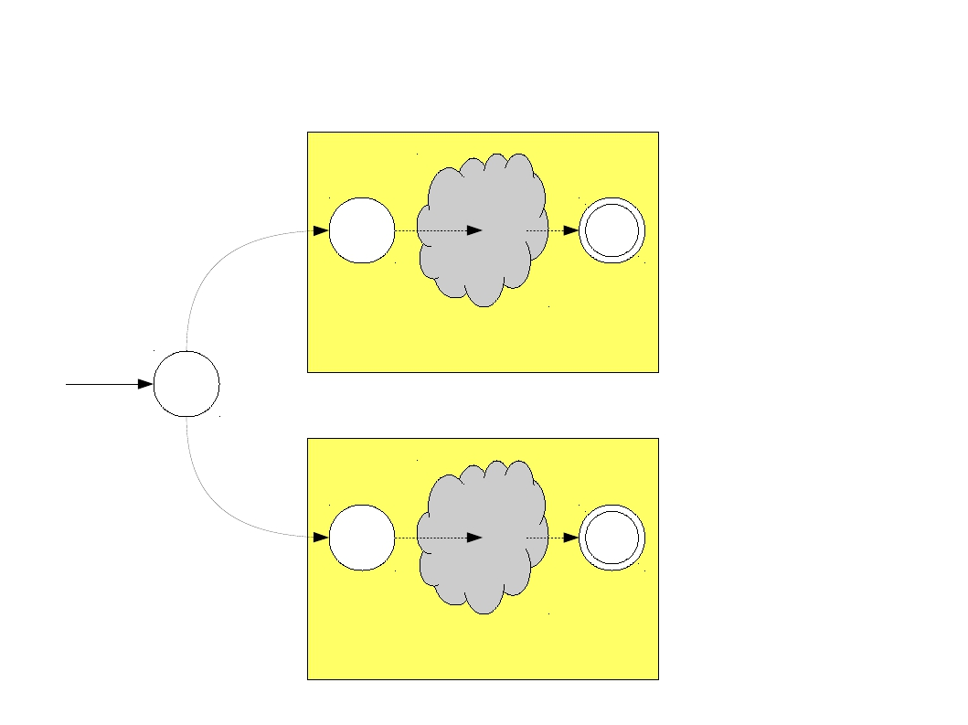
Construction for R1 | R2
ε
start
R1
R2
ε

Slide 22
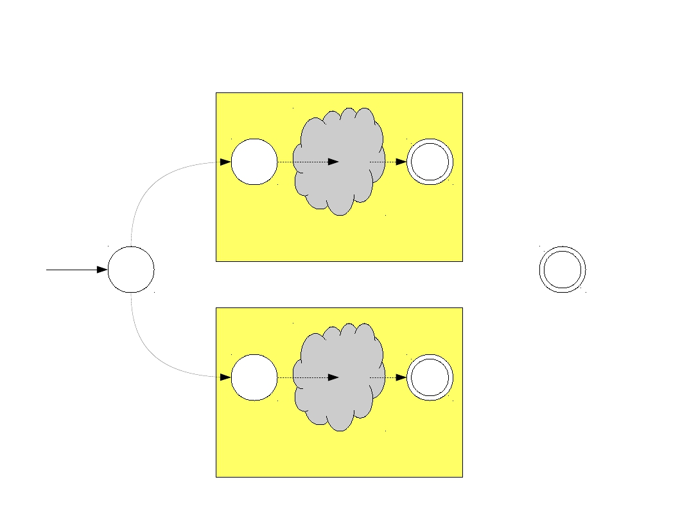
Construction for R1 | R2
ε
start
R1
R2
ε

Slide 23
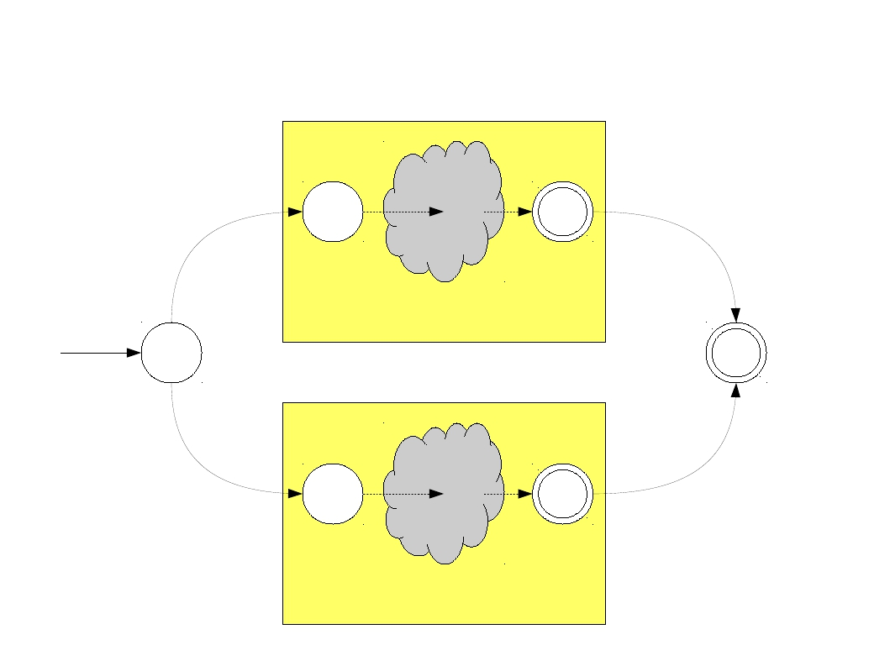
Construction for R1 | R2
ε
ε
ε
start
R1
R2
ε

Slide 24
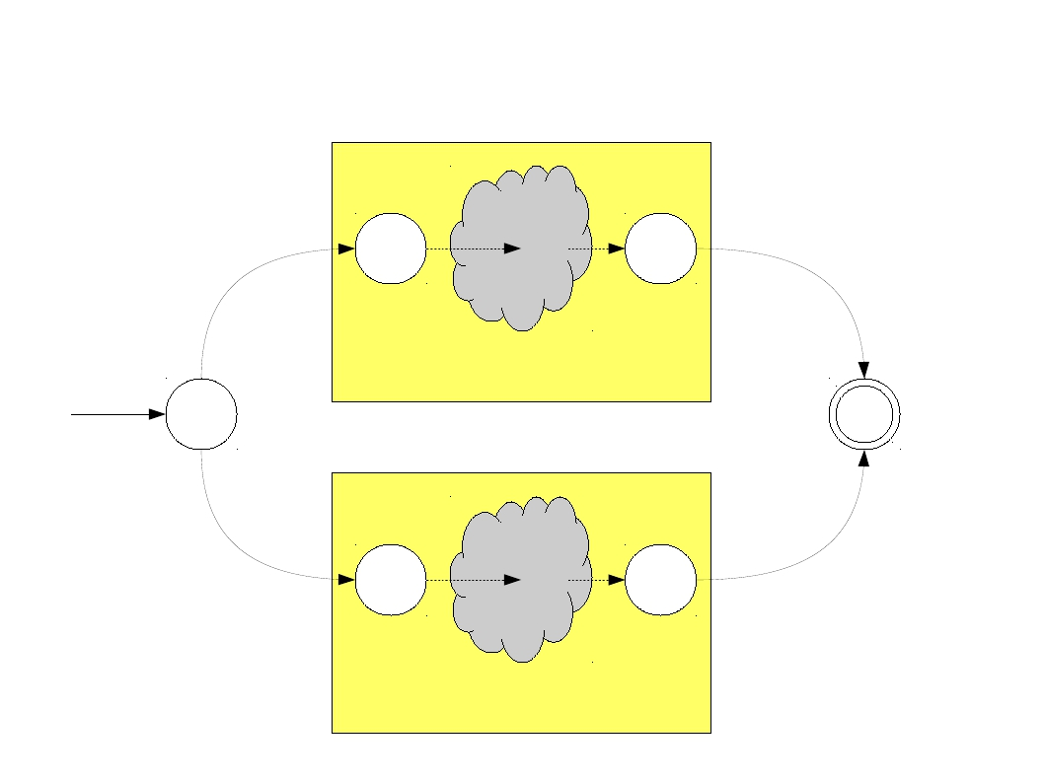
Construction for R1 | R2
ε
ε
ε
start
R1
R2
ε

Slide 25
Construction for R*

Slide 26
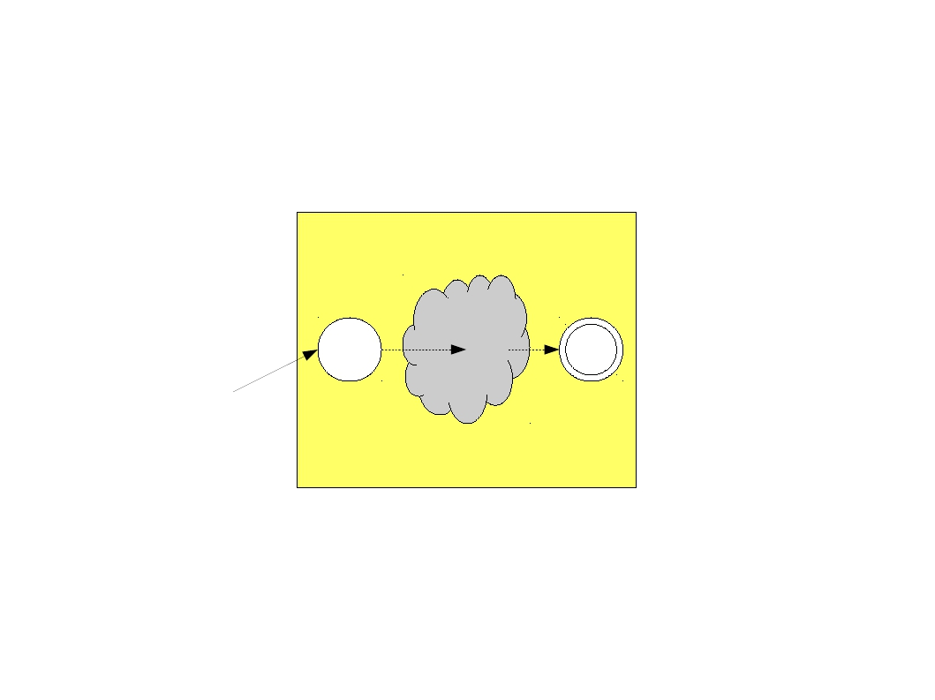
Construction for R*
start
R

Slide 27
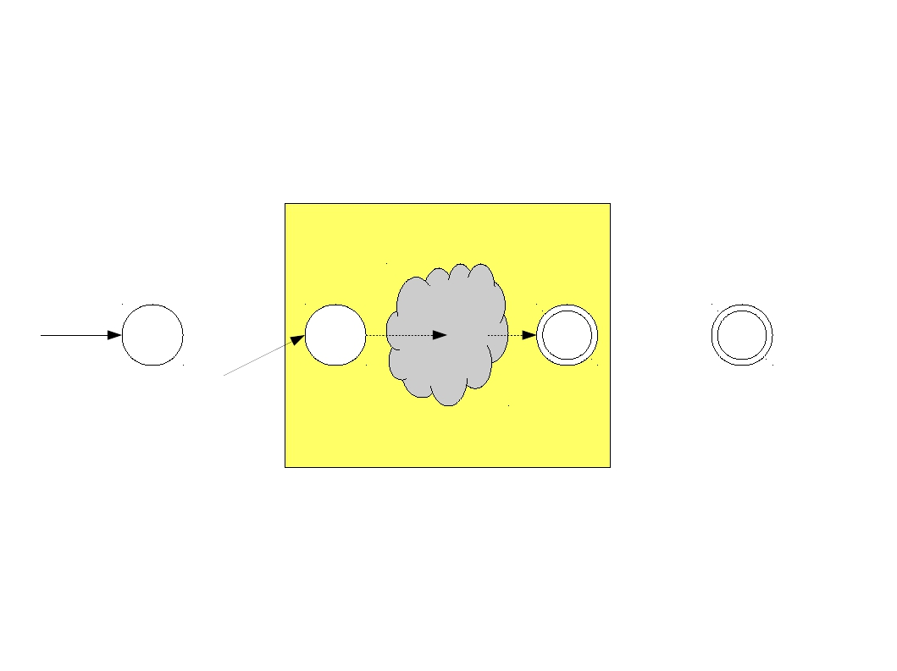
Construction for R*
start
start
R

Slide 28
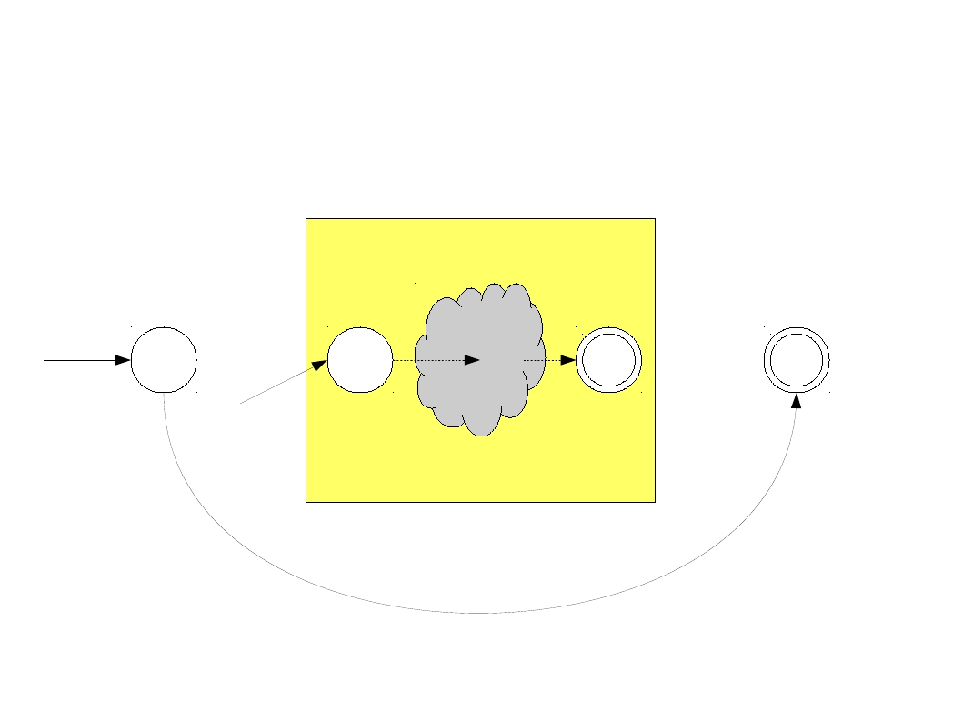
Construction for R*
start
start
R
ε

Slide 29
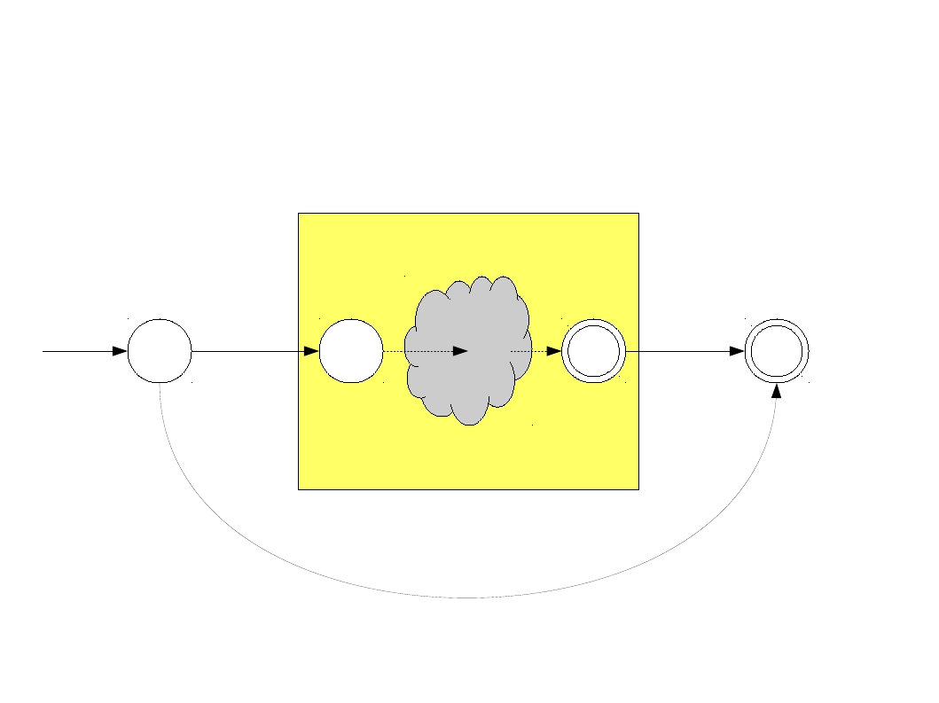
Construction for R*
start
ε
ε
R
ε

Slide 30
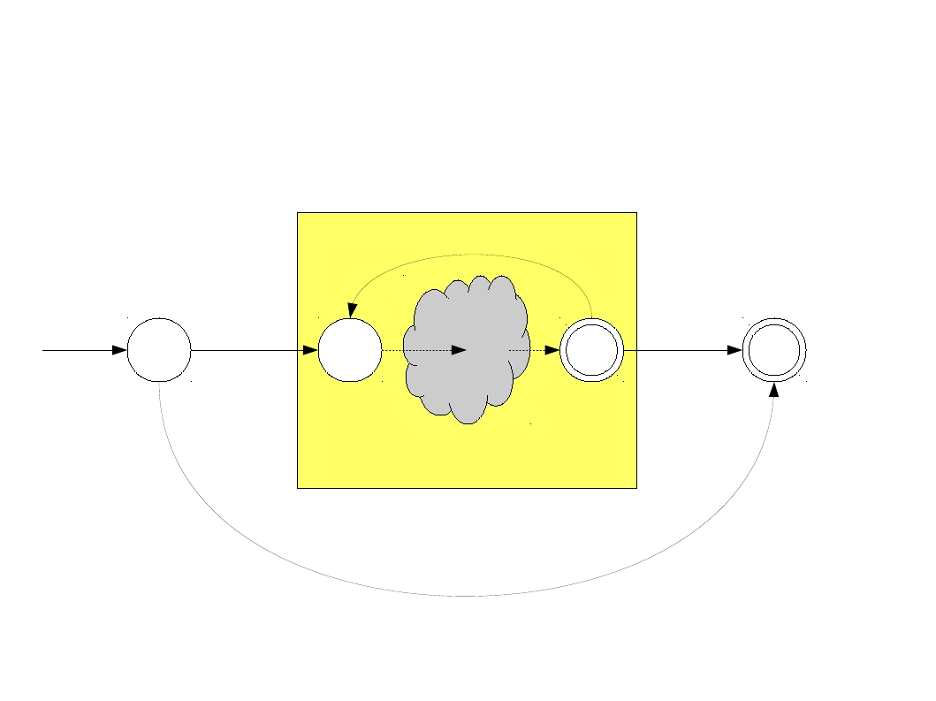
Construction for R*
ε
start
ε
ε
R
ε

Slide 31

Construction for R*
ε
start
ε
ε
R
ε

